Slide 1

UiPath stock price analysis 2024-2025
Students: GHEORGHITA DENISA-ELENA
NEMERENCO ANA

Slide 2
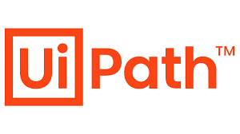
1. Introduction
Literature review, Research Question & Methodology
In recent years, automation and artificial intelligence have become central to how companies operate and innovate, and UiPath stands out as one of the leading players in this transformation.
We chose to analyze the UiPath stock price in 2024 because it provides valuable insight into how the market perceives the growth and stability of the automation industry during a period marked by rapid technological advancement and economic uncertainty.
By examining UiPath’s financial performance, trends, and volatility, we aim to understand not only the company’s position in the tech sector but also how investor confidence and global market dynamics influenced its valuation throughout 2 last years.

Slide 3
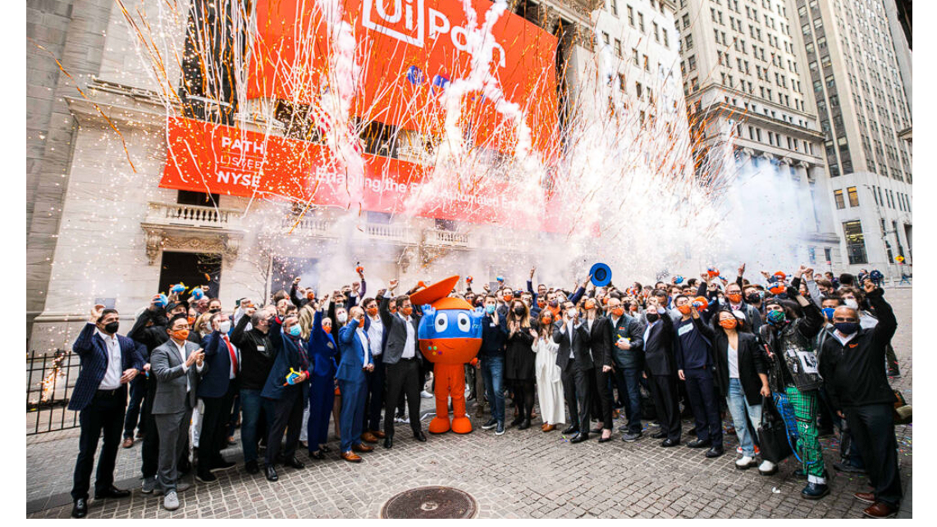
We found extensive research showing that Uipath’s growth and stock performance are strongly influenced by broader market trends and investor sentiment toward automation and AI technologies.
In its early years, rapid revenue growth and innovation played a key role in boosting investor confidence. However, after reaching a certain level of market maturity, other factors became more relevant—such as profitability, competition, and long-term sustainability. As the automation industry evolves, uipath’s valuation depends less on short-term hype and more on its ability to maintain consistent growth, efficiency, and leadership in the ai-driven enterprise software sector.
1. https://pe-insights.com/uipath-goes-public-in-one-of-the-biggest-us-software-ipos/

Slide 4
The fastest growing enterprise software company ever
UiPath grew from $1M in revenue in 2015 to over $200M in annual recurring revenue within just a few years.
Initially underestimated by many investors, UiPath’s success came from its visionary leadership, flexible technology, and strong focus on customer needs.
The company’s strategy building local sales teams, launching a free community edition, and creating UiPath Academy fueled global adoption and rapid scaling, turning a small Romanian startup into a global automation leader.
1. https://blog.openocean.vc/how-uipath-found-the-model-for-scaling-faster-than-everyone-thought-possible-2fdd71004ac8
2. https://www.uipath.com/newsroom/uipath-named-fastest-growing-technology-company

Slide 5
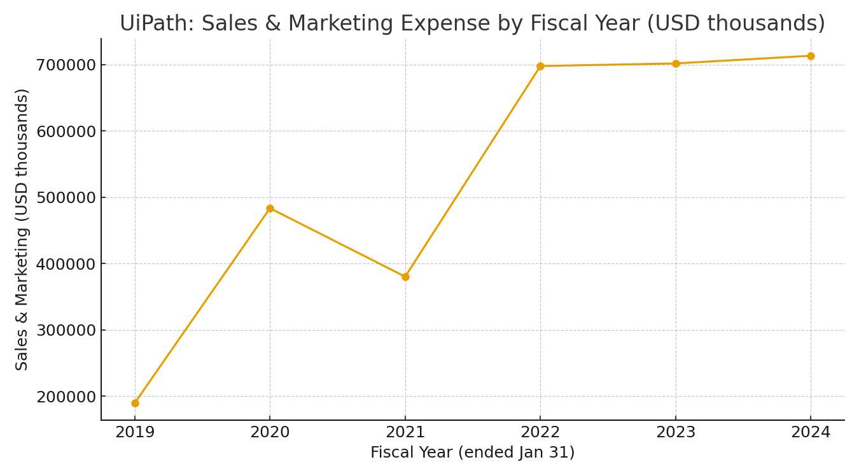
Sales and marketing expenses

Slide 6
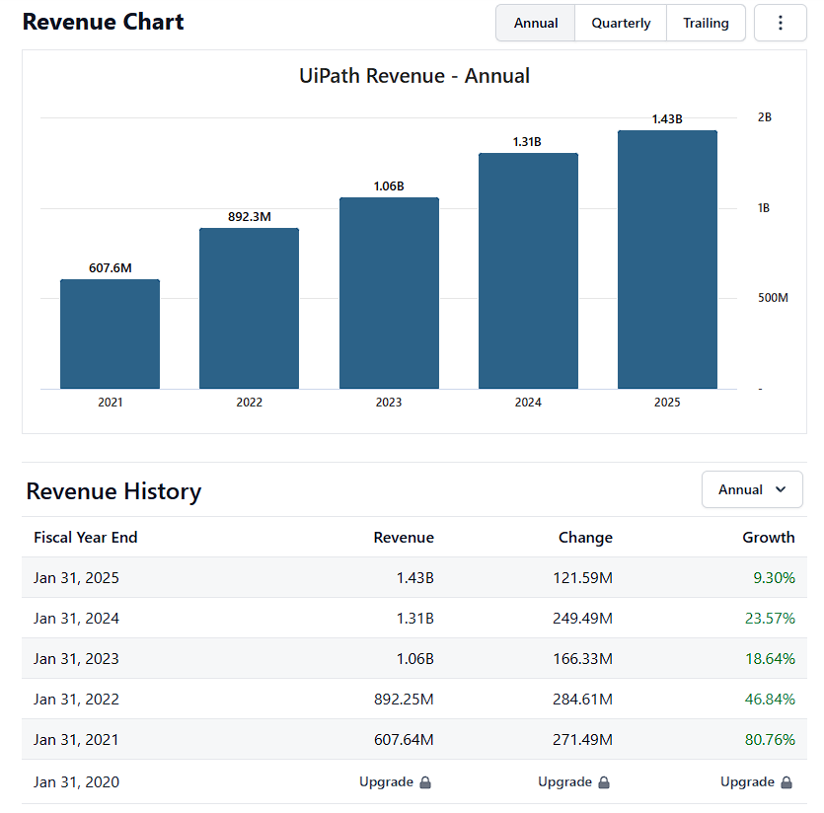
Automation at Scale: Tracking UiPath’s Revenue Evolution
Between 2021 and 2025, UiPath’s revenue grew significantly—from $607.6 million to $1.43 billion—showing strong overall expansion but a gradual slowdown in growth rates.
The company experienced rapid early growth (over 80% in 2021) driven by rising global adoption of automation solutions, followed by steady increases as it matured and expanded its enterprise customer base. By 2025, growth had moderated to 9.3%, reflecting UiPath’s transition from a high-growth startup to a more established, stable technology leader focused on scaling efficiently and maintaining consistent long-term performance.
1. https://stockanalysis.com/stocks/path/revenue/

Slide 7
Automation at Scale: Tracking UiPath’s Revenue Evolution
Research focus
To analyze UiPath’s stock price dynamics during 2024-2025
Compare UiPath’s stock price change with a similar tech company (e.g., Palantir).
Analyze the correlation between revenue growth and stock performance.
Examine stock volatility for both companies.
Identify key strategic events that may have influenced stock movement.
1. https://stockanalysis.com/stocks/path/revenue/

Slide 8
Stock data from Yahoo Finance was used for quantitative analysis.
The dataset includes UiPath (PATH) and Palantir (PLTR) between 2024–2025.
Data was collected and analyzed in Python using yfinance, pandas, matplotlib, and statsmodels.
Methodology
Key Parameters:
Closing price (daily)
20-day & 50-day moving averages
Trading volume
ADF stationarity test
Price volatility

Slide 9
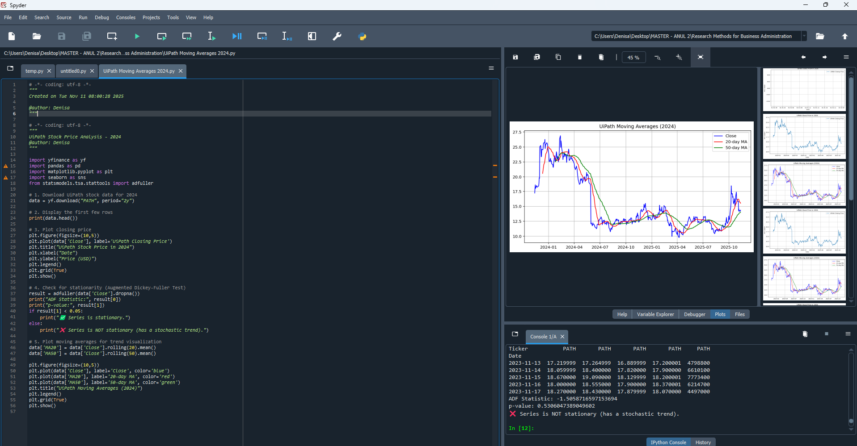
We used Spyder to analyze the data
Methodology

Slide 10
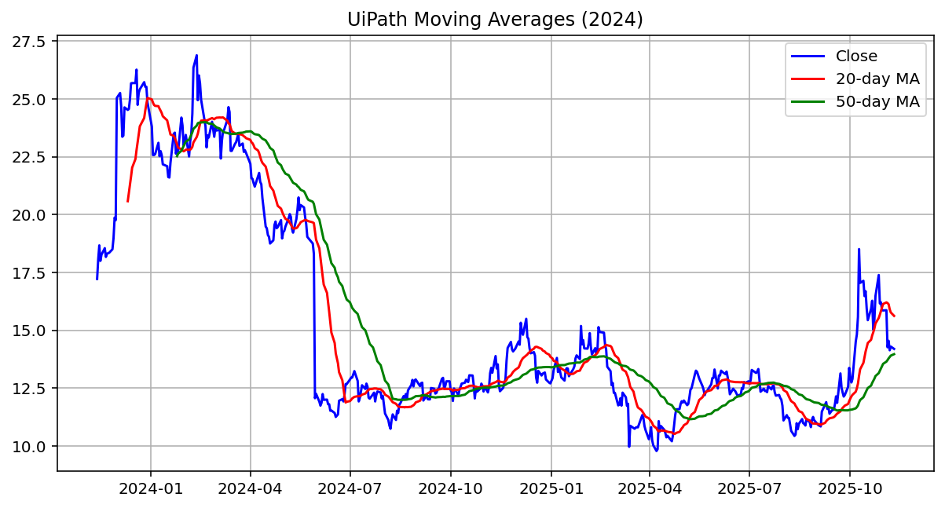
2. Findings
This chart shows UiPath’s stock price movements (Close) throughout 2024 and 2025, along with its 20-day (red line) and 50-day (green line) moving averages.
The price peaked around $25–27 in early 2024, then declined sharply to about $12 by mid-2024. It stayed relatively flat through early 2025 before starting to rise again around mid-2025, reaching another peak near $20+ in late 2025.The 20-day moving average reacts faster to short-term changes, while the 50-day average smooths longer trends — their crossovers indicate potential trend reversals in the stock’s momentum.

Slide 11
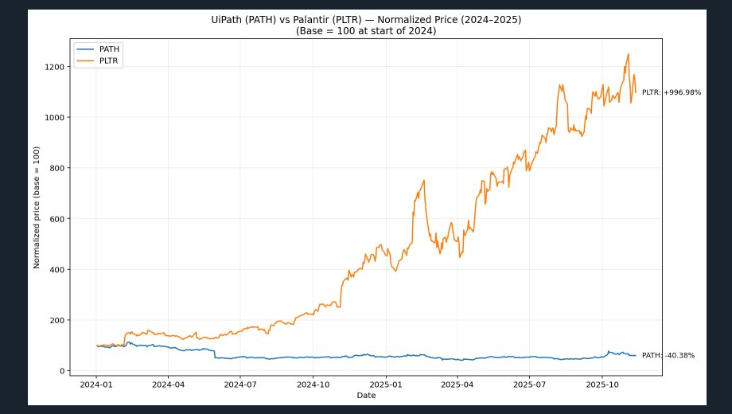

Slide 12

Both price lines start at a base value of 100, allowing us to easily compare their relative performance rather than their absolute stock prices.
When a line rises above 100, it indicates that the stock price has increased relative to the start of 2024. Conversely, when it falls below 100, the stock has declined compared to its initial level.
The slope of each line reflects the momentum and volatility of the stock:
Steeper upward slopes show periods of rapid price growth.
Sharp downward slopes indicate corrections or sell-offs.
The final values (annotated on the right side of the chart) show the total percentage change for each stock over the selected period. The company with the higher ending line (and larger positive percentage) has outperformed its peer in total return since early 2024.
Typically, Palantir (PLTR) exhibits higher volatility and stronger upward momentum due to its AI-driven business narrative and investor enthusiasm, while UiPath (PATH), though also AI-oriented, tends to trade more steadily as an enterprise automation software company.

Slide 13
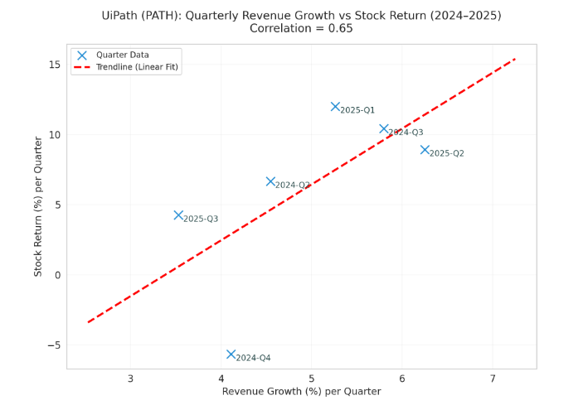
The chart suggests a moderate positive correlation between UiPath’s quarterly revenue growth and its stock returns during 2024–2025. In quarters with stronger revenue growth, stock performance tended to improve. However, deviations from the trendline highlight that other factors — such as market sentiment, guidance, or macro events — also influenced UiPath’s share price.

Slide 14
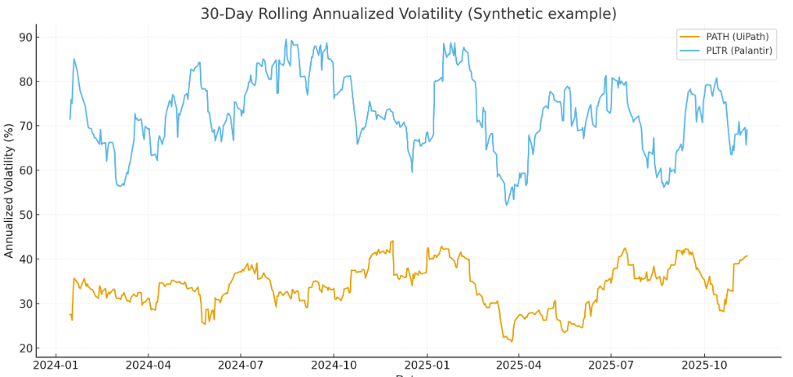
The time series shows the 30-day rolling annualized volatility (in percent) for UiPath (PATH) and Palantir (PLTR). Peaks indicate periods of large price swings (higher short-term risk). In this synthetic example, PLTR displays consistently higher volatility than PATH, which would imply larger average price movements and potentially higher risk/return.

Slide 15

Positive events (e.g., strong growth, new partnerships, strategic positioning) tend to coincide with upward inflection points in the stock — investors see future potential and reward the company.
Negative/uncertain events (e.g., slowing growth, weak guidance, macro headwinds) often precede pullbacks or volatility spikes — as perception shifts from growth to risk.
Because UiPath is a growth stock, the market is sensitive not just to actual results but to expectations and forward guidance. A strong partnership might boost sentiment, but if growth slows nonetheless, the stock may not respond positively.

Slide 16
Thank you for attention!

